Slide 1
Render Portfolio for Populus Magos
a god game by Mario Battiston

Slide 2
TABLE OF CONTENTS
01
02
03
04
05
Brief Intro to Populus Magos
Each 3d Model rendered
Lighting
Camera (Isometric)
Scenes

Slide 3
01
Brief Intro to Populus Magos

Slide 4
Populus Magos
Story Intro
Game Summary
Populus Magos is a god game that takes inspiration from the great Populus 2 Trials of The Olympian Gods from developers Bullfrog Productions and publishers EA.
In the world of Populus Magos the Milky Way galaxy (our Galaxy) Stars are dying and the human colonies of the 21st Millenium are in peril of extinction. The Star Forgers is a Astra Faction that was formed in response the perils and they are tasked with traversing the exo-reaches for exo-planets that have been proven to have the resources necessary to reforge stars or forge new ones.
Magos is one such planet. And Magos is your mission. You are a Star Forge Astra Overseer of the Astra Formation 451 of the Star Forge Legion. Establish the Forgeworld, extract its Recources and Save our Stars!

Slide 5
02
Each 3d Model rendered

Slide 6
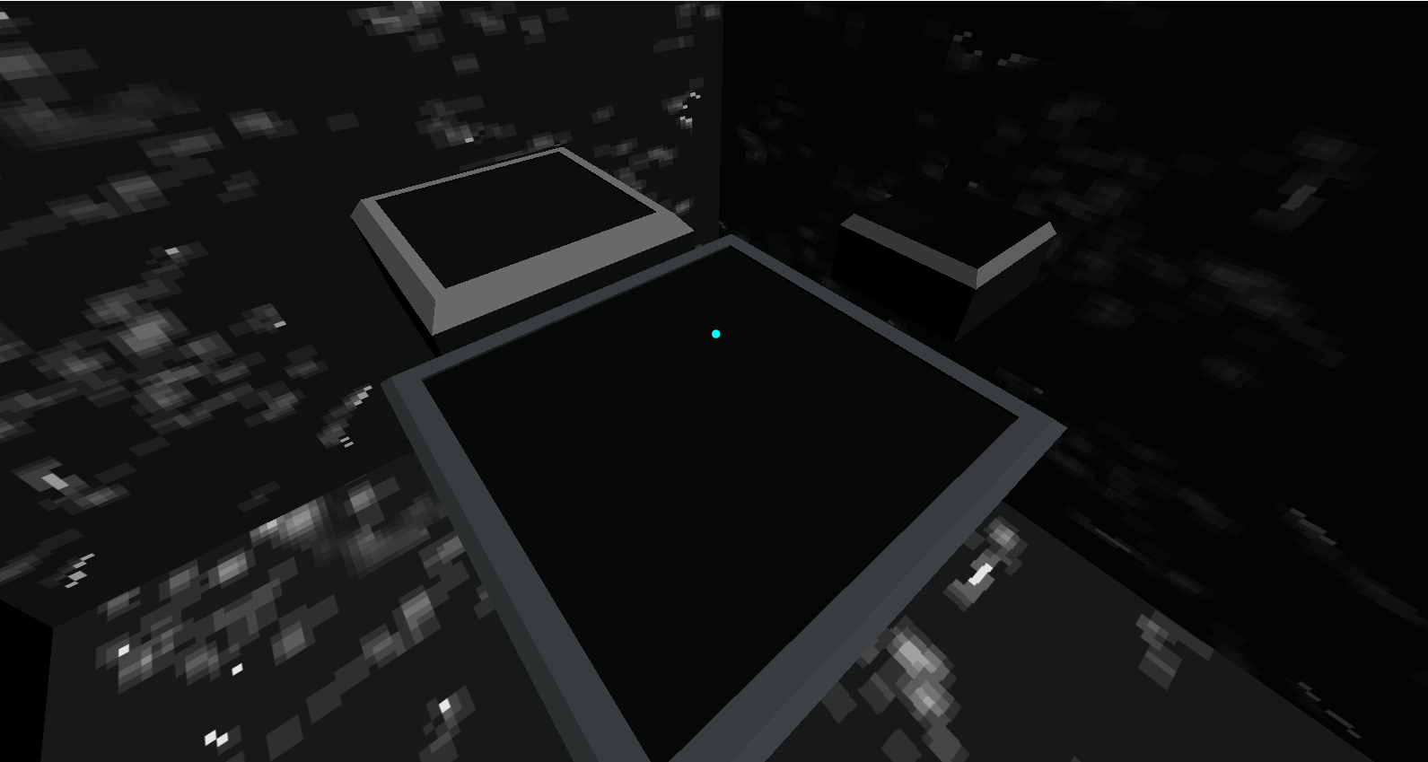

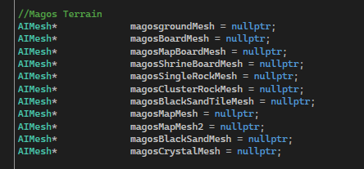
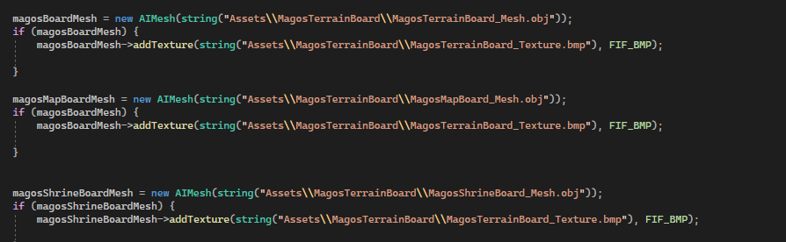
Terrain Board Meshes
Camera View
General
Terrain Board
Main Board plane mesh where the game will play on
Map Board mesh for the map and navigating where you are on the map.
Shrine board mesh the board on which the shrine will be set upon. (This shrine will light different colors depending on if the player or enemy is winning acting as some visual communication)
Texture
Set up Code
UVs are shrunk significantly to fit in the individual colors to achieve the desired effect. Practically a fill tool for individual UVs.

Slide 7
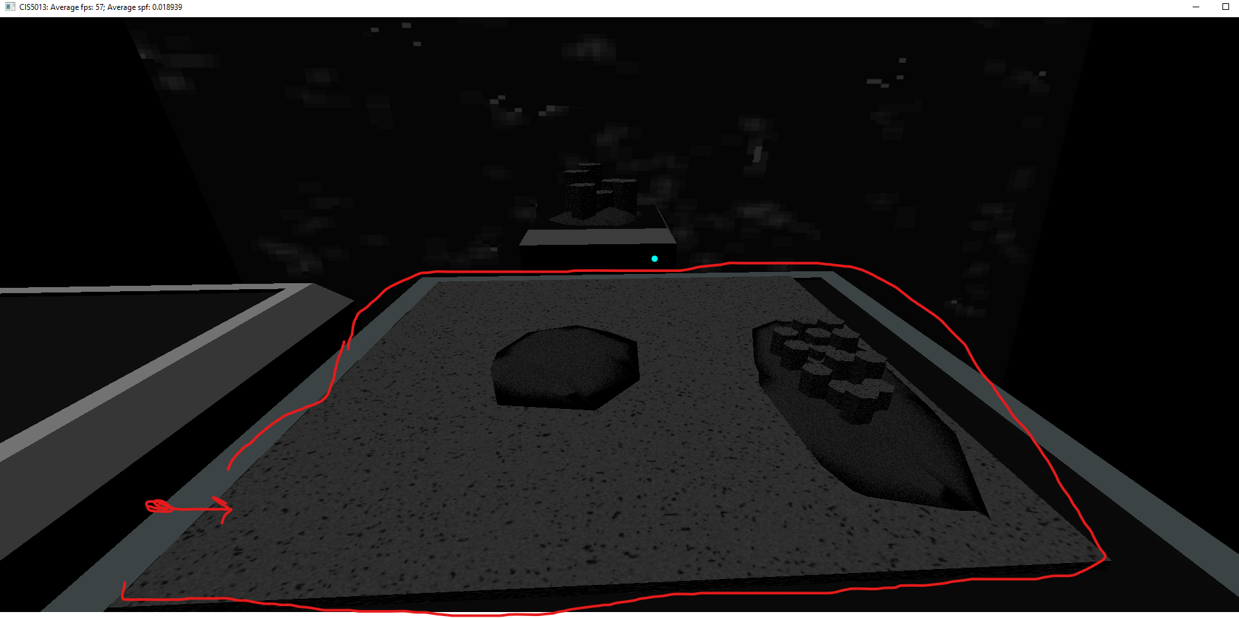


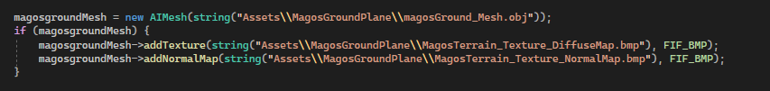
Ground Plane Mesh
Ground Plane
General
The Ground plane is the main object on which the game will take place on. Where on objects such as characters buildings and terrain will be rendered.
Set up Code
Texture
Diffuse Map
Normal Map

Slide 8
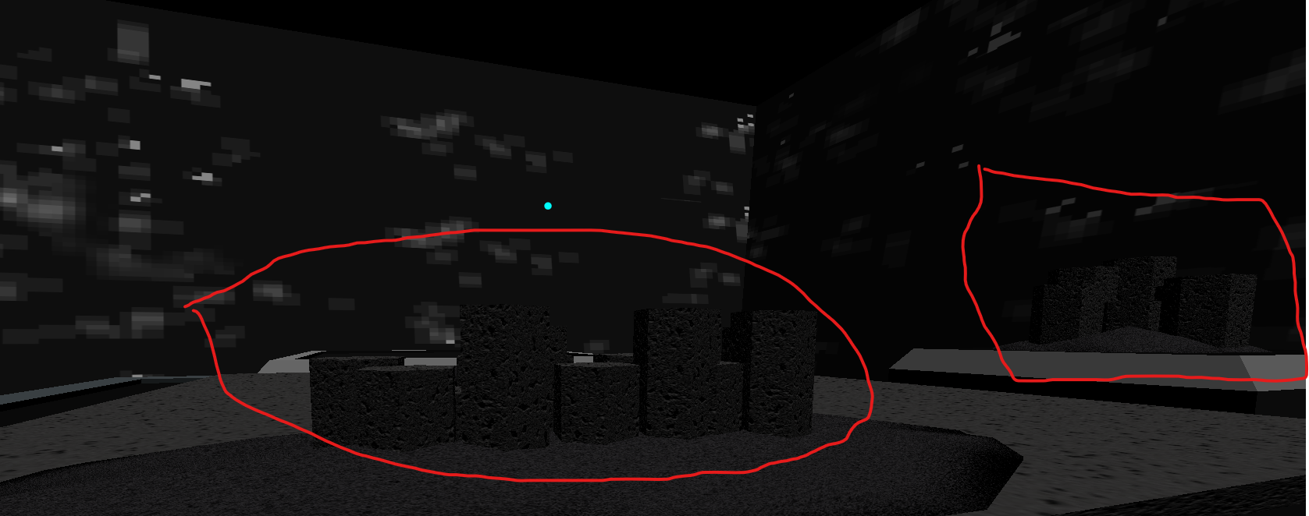
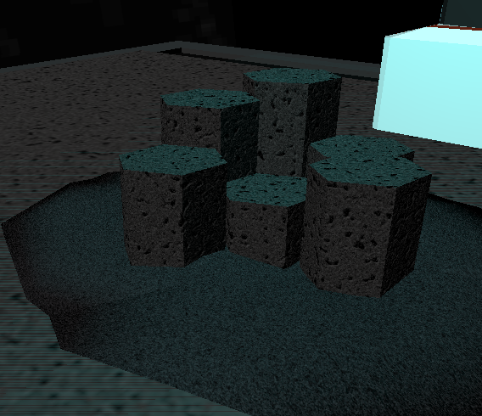
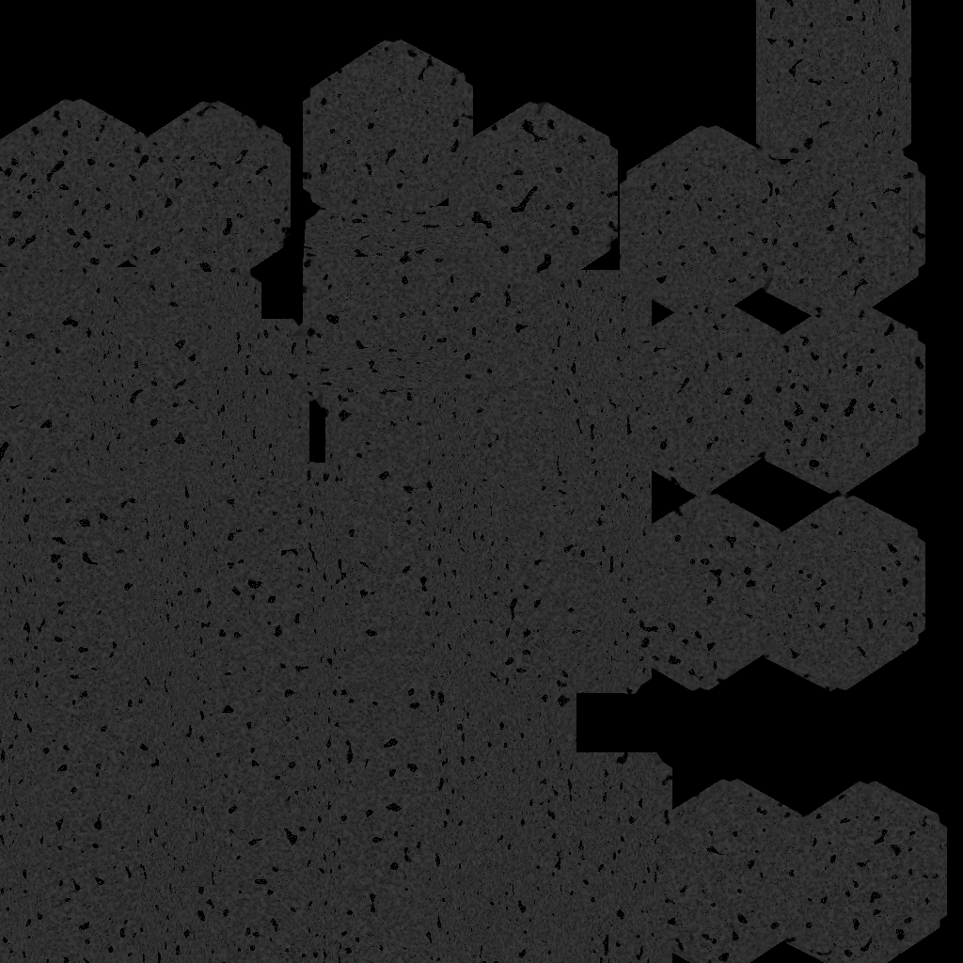

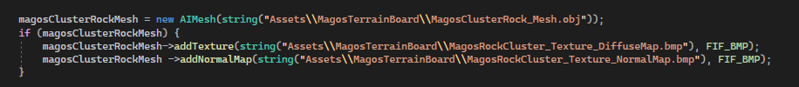
Cluster Rock Mesh
General
The Cluster rock mesh is used as terrain and as part of the shrine and is sometimes coupled with the crystal mesh.
Also used as terrain that cannot be built on and will need to be lowered or raised by the player.
Texture
Set up Code
Diffuse Map
Normal Map

Slide 9
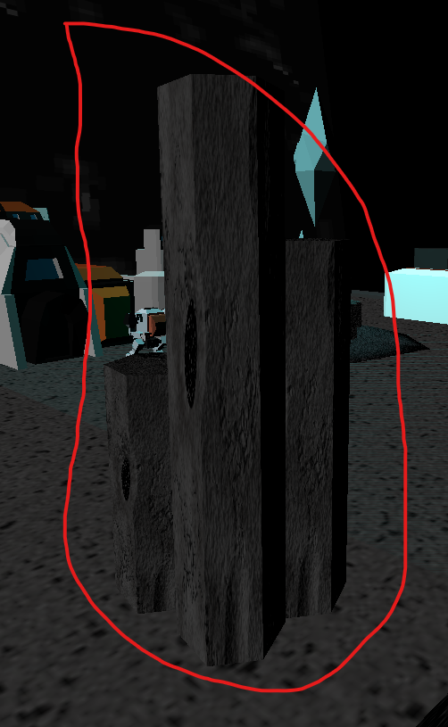
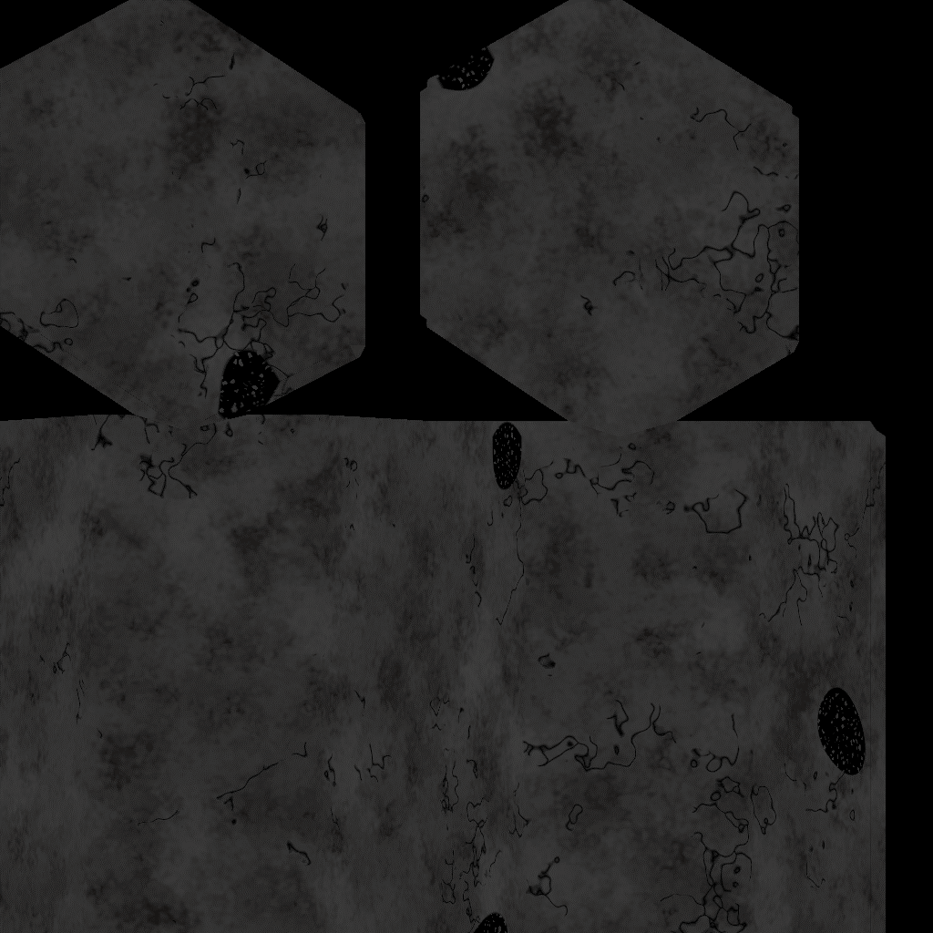

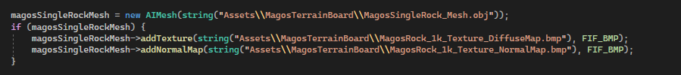
Single Rock Mesh
Texture
Diffuse Map
Normal Map
Set up Code
The Single rock mesh is used as terrain.
Also used as terrain that cannot be built on and will need to be lowered or raised by the player.

Slide 10
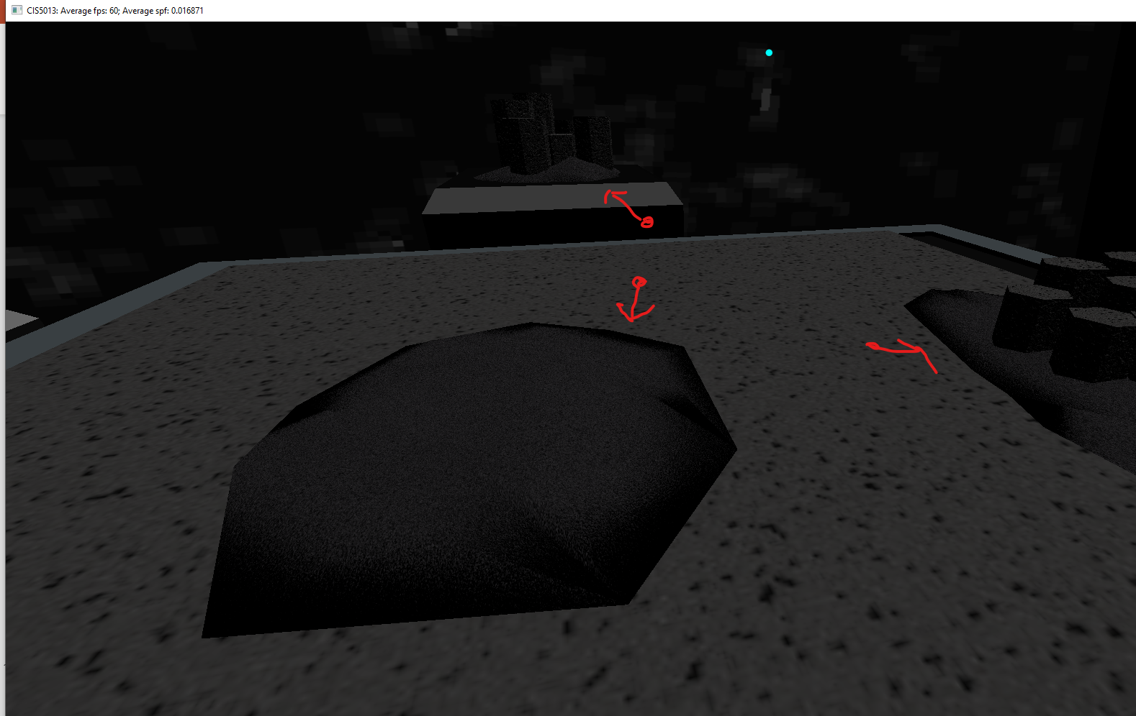
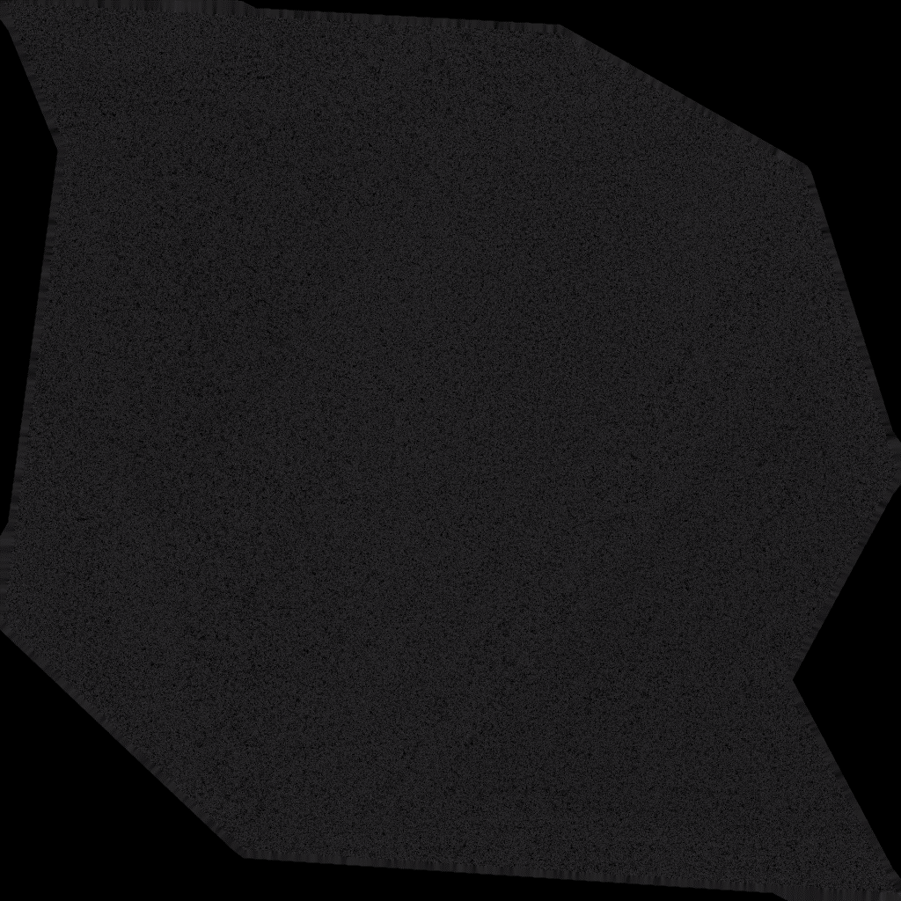

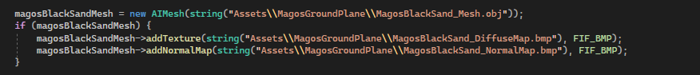
Magos Black Sand
Texture
Diffuse Map
Normal Map
Set up Code
General
The Magos black sand mesh is used as terrain.
Also used as terrain that cannot be built on and will need to be lowered or raised by the player.

Slide 11
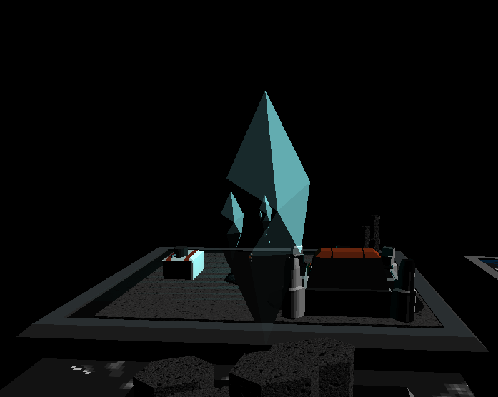
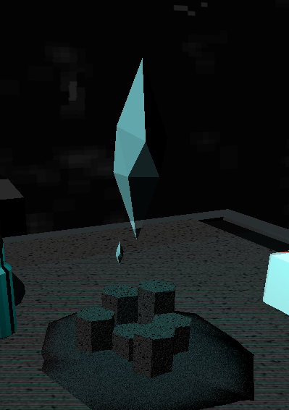
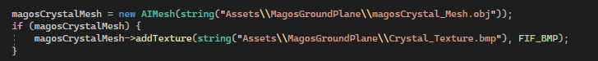
Magos Crystal Mesh
Texture
UVs are shrunk significantly to fit in the individual colors to achieve the desired effect. Practically a fill tool for individual UVs.
General
Set up Code
The Magos Crystal mesh is used as terrain.
Also has a mechanic behind them and they boost the power of player by upgrading all budlings significantly faster if they are built around the crystal.

Slide 12
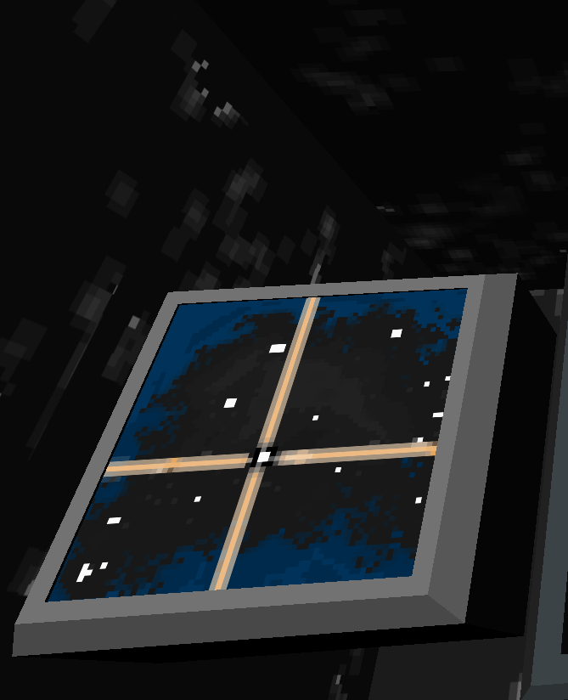
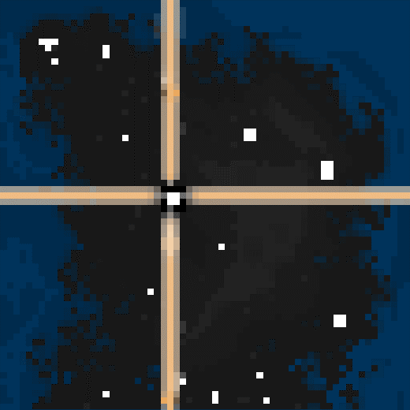
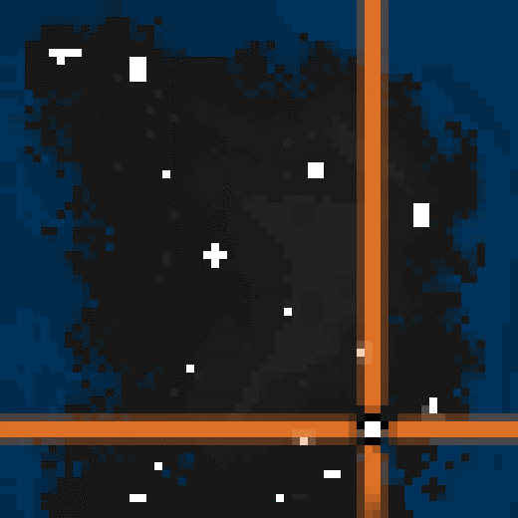
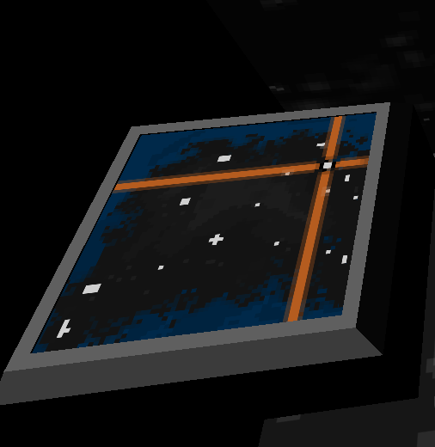
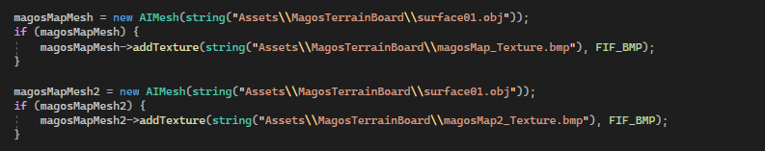
Maps Maps
Magos Map
Textures
Magos Map 2
General
Magos Map
Magos Map 2
The Magos maps meshes will be used to navigate where the player is and where settlements are as well as what the areas look like.
Magos Map 2
Set up Code

Slide 13
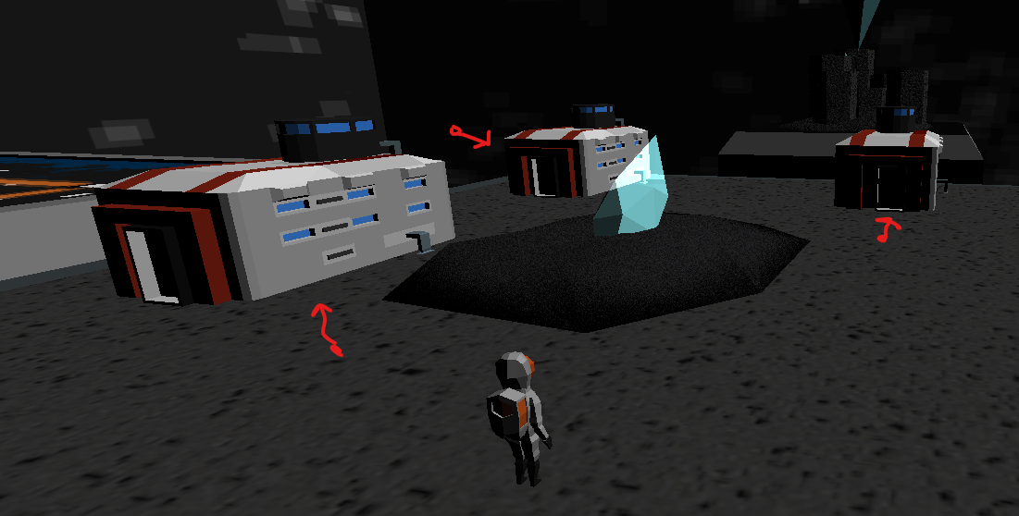
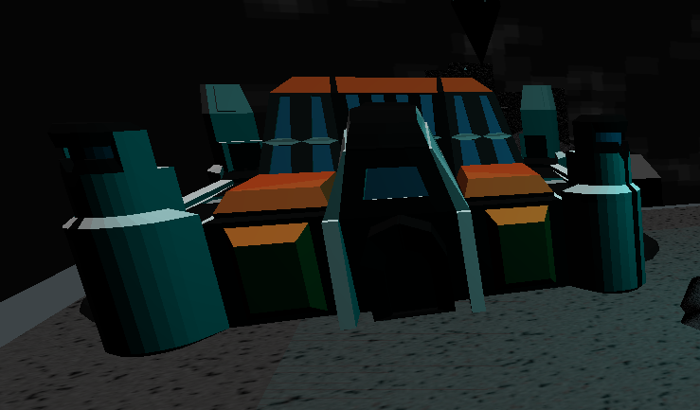
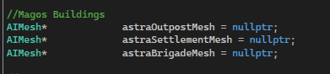
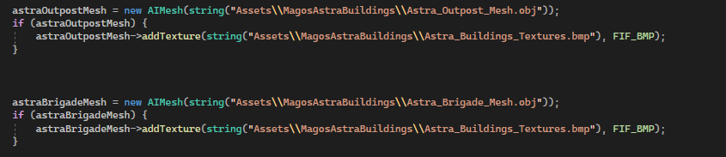
Astra Building Meshes
Astra outpost Mesh
General
Textures
The astra building meshes are the budlings of Populus Magos. They are built on safe terrain by the AI and have 3 levels.
Level 1: Astra Outpost
Level 2: Astra Settlement
Level 3: Astra Brigade
UVs are shrunk significantly to fit in the individual colors to achieve the desired effect. Practically a fill tool for individual UVs.
Astra Brigade Mesh
Set up Code

Slide 14
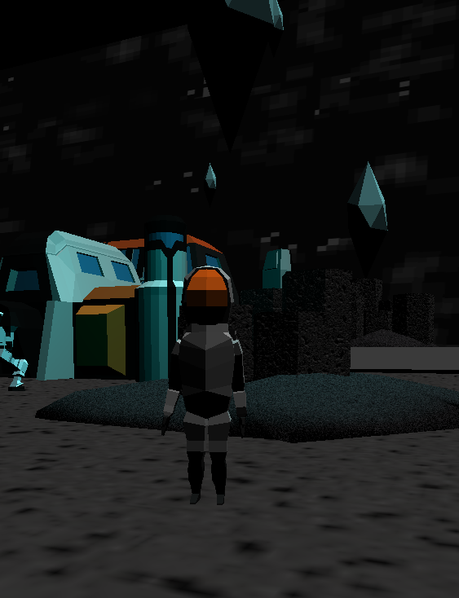
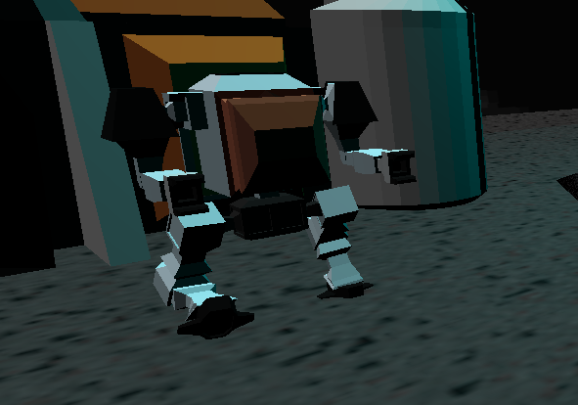
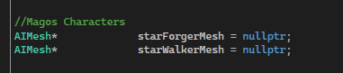
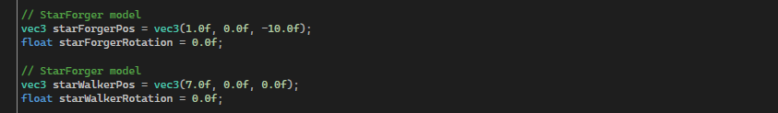
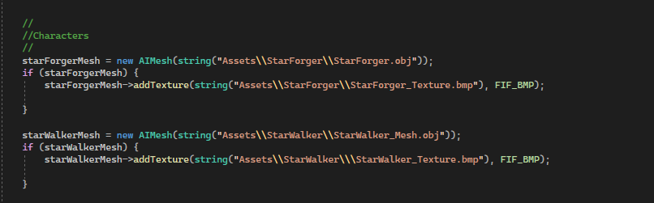
Star Forger & Star Walker Meshes
Star Forger Mesh
General
Textures
The Star Forger meshes are your main NPC citizens that build buildings on safe terrain.
The Star Walker meshes are your warrior units that come about once the astra brigade building is built. They fight your advisory and destroy/claim the advisories buildings.
UVs are shrunk significantly to fit in the individual colors to achieve the desired effect. Practically a fill tool for individual UVs.
Star Walker Mesh
Set up Code

Slide 15
03
Lighting

Slide 16
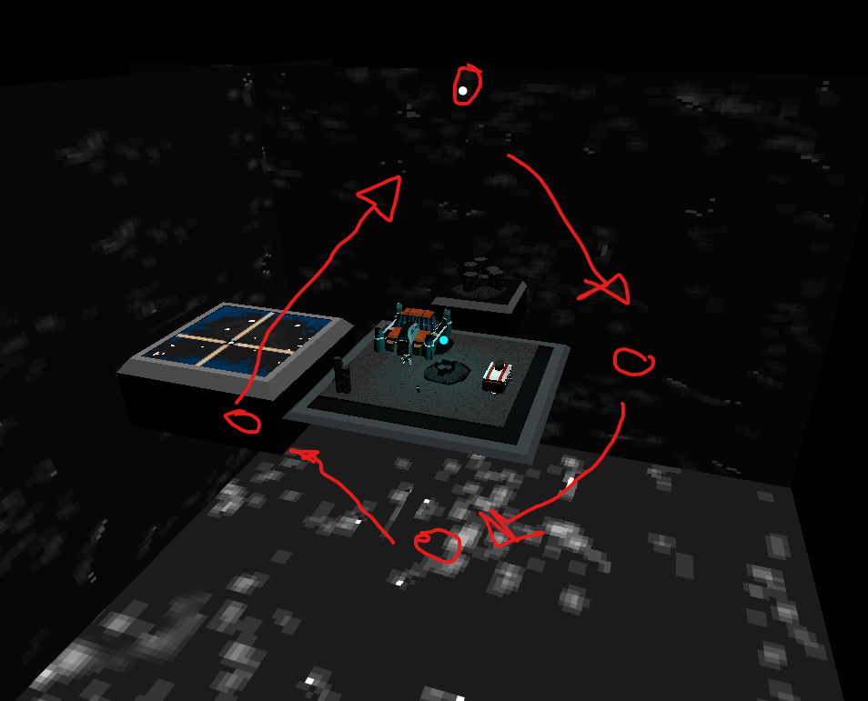
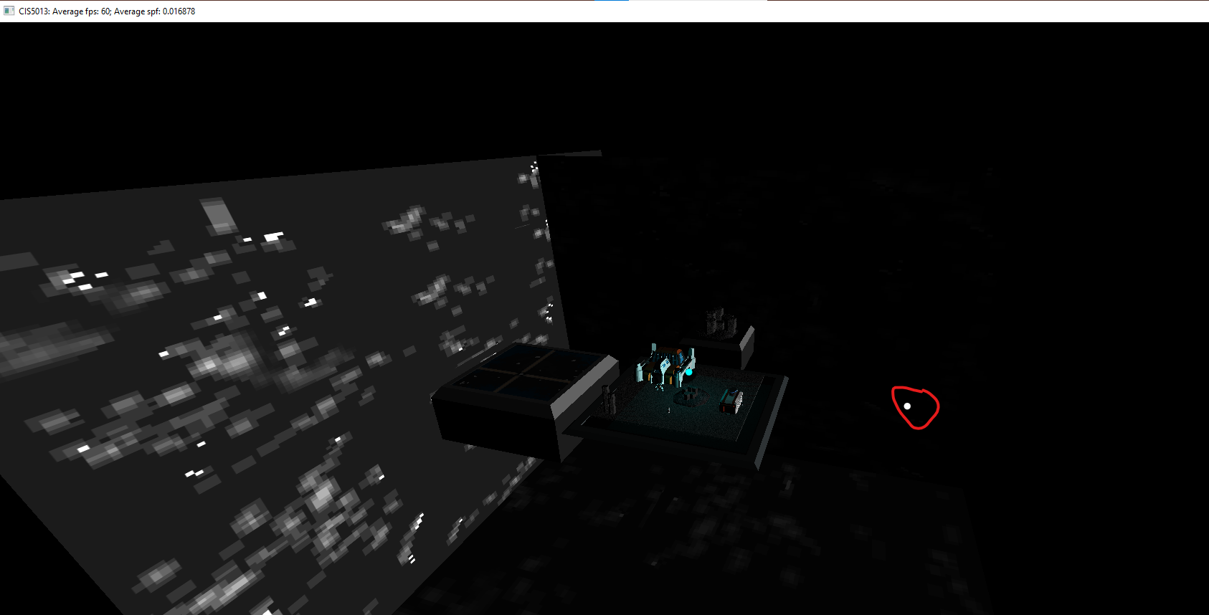
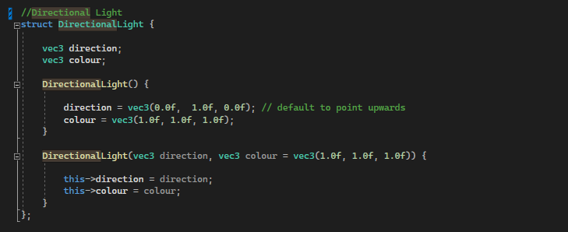
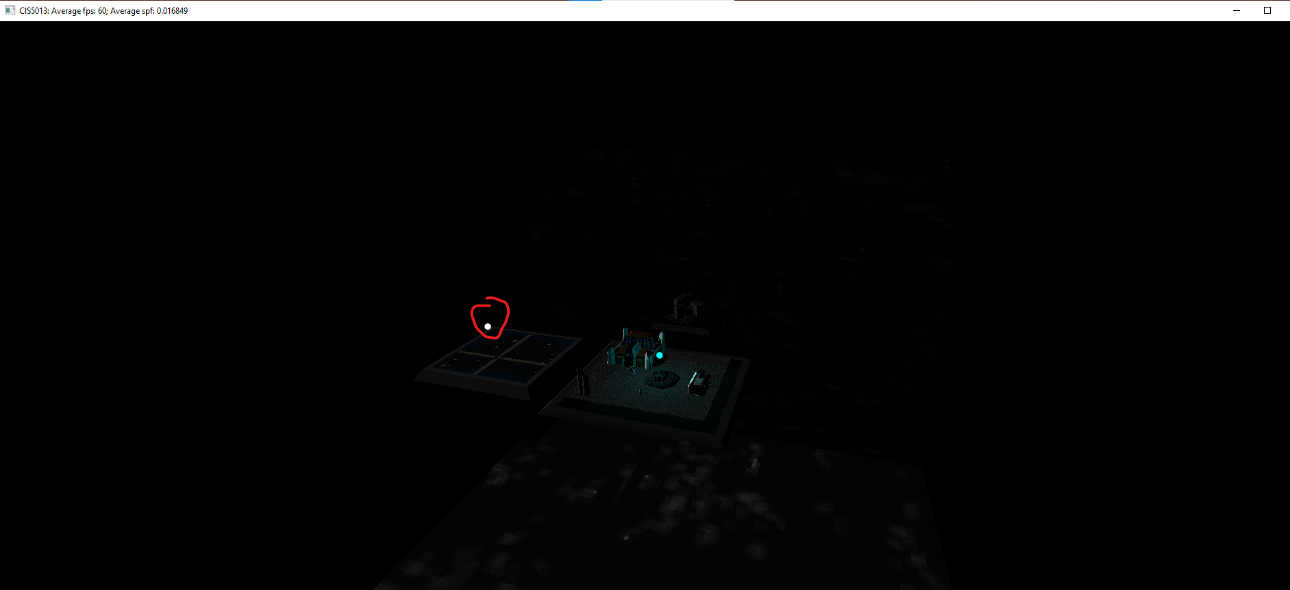
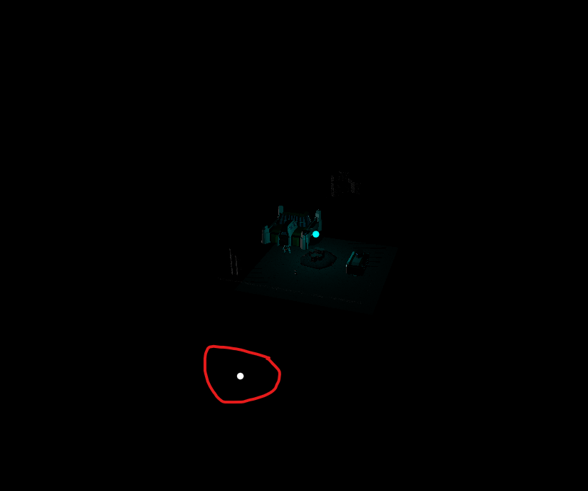
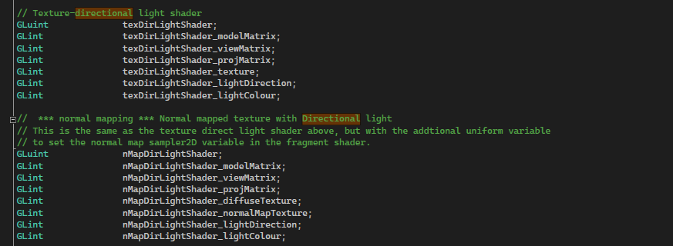
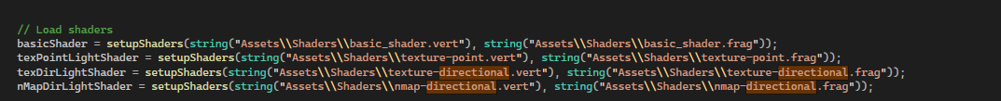
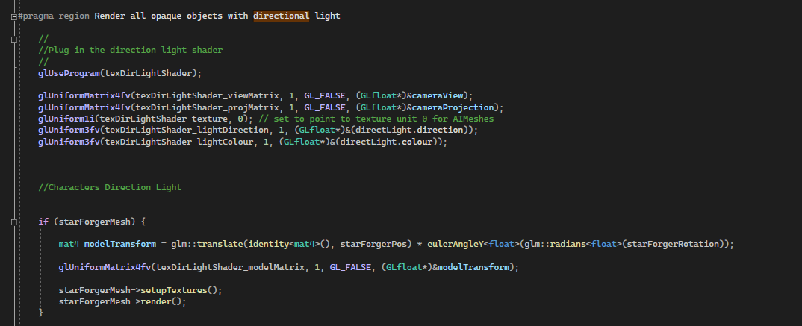
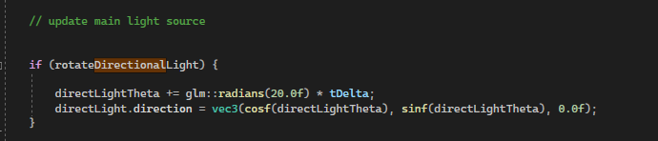
Directional Light
Set up Code
Rotate Code

Slide 17
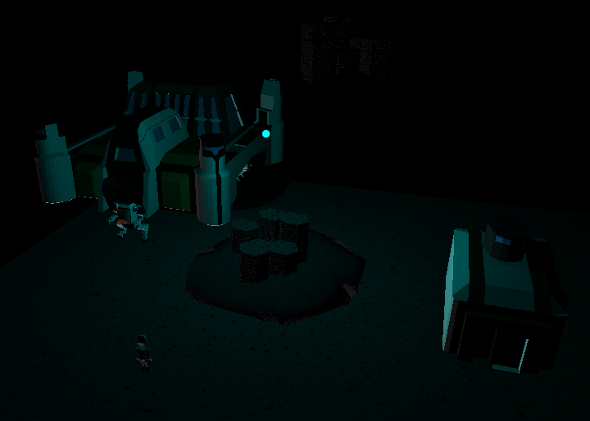
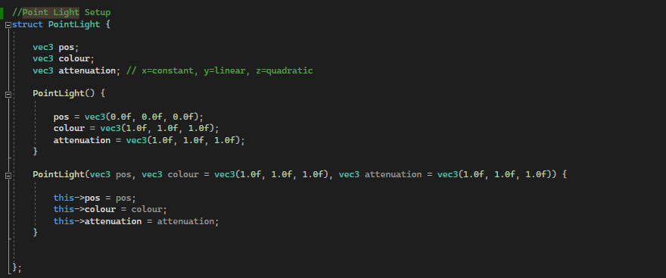
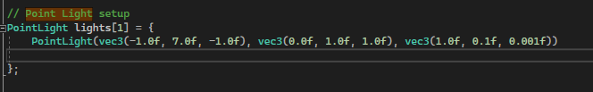
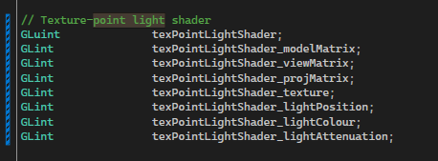
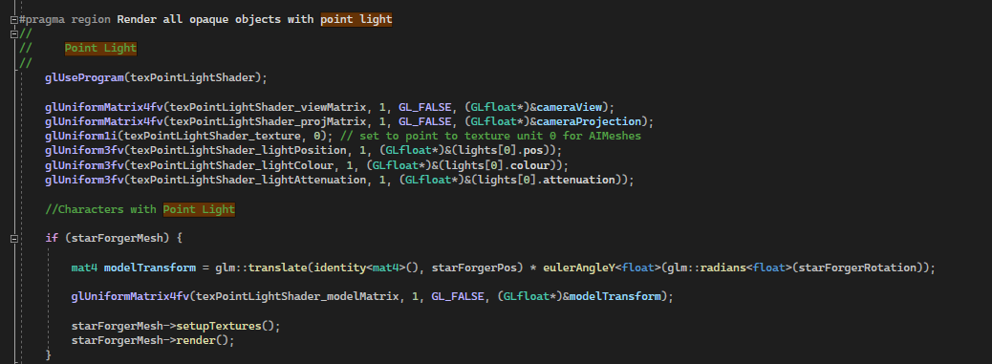
Point Light
Set up Code

Slide 18
04
Camera (Isometric)

Slide 19
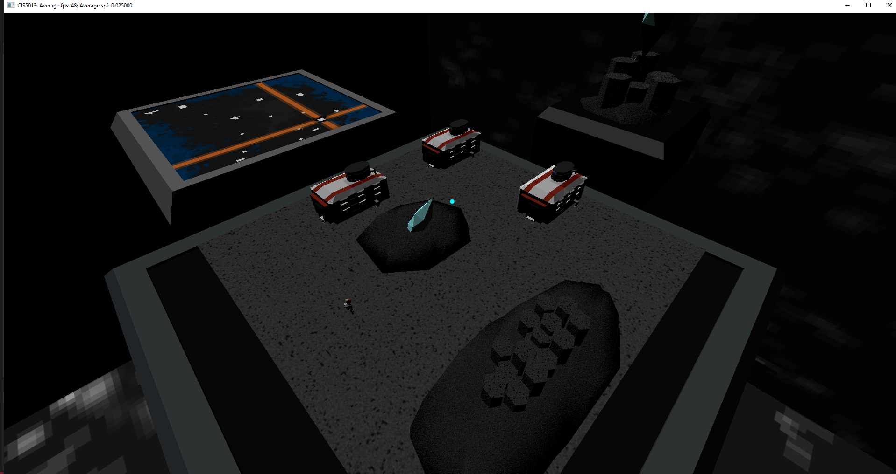
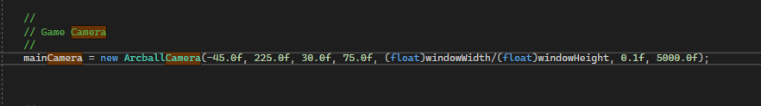
Isometric Camera
Camera Code
Populus Magos like the game it is based on will be an Isometric god game and so Populus will have an isometric game camera. Following x axis 30 and y axis 45.

Slide 20
05
Scenes

Slide 21
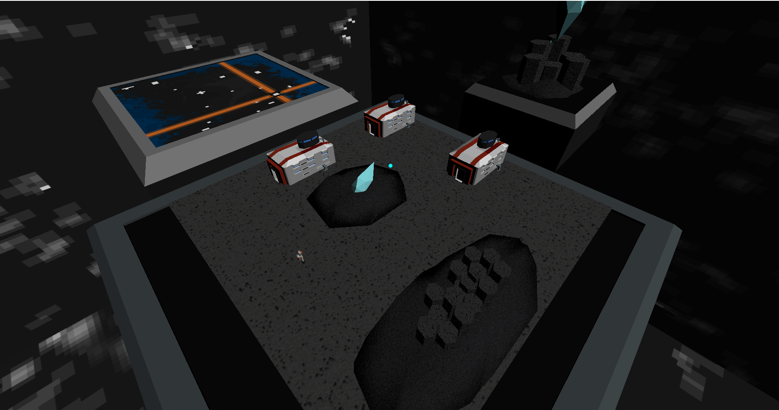
Populus Magos Level 1

Slide 22
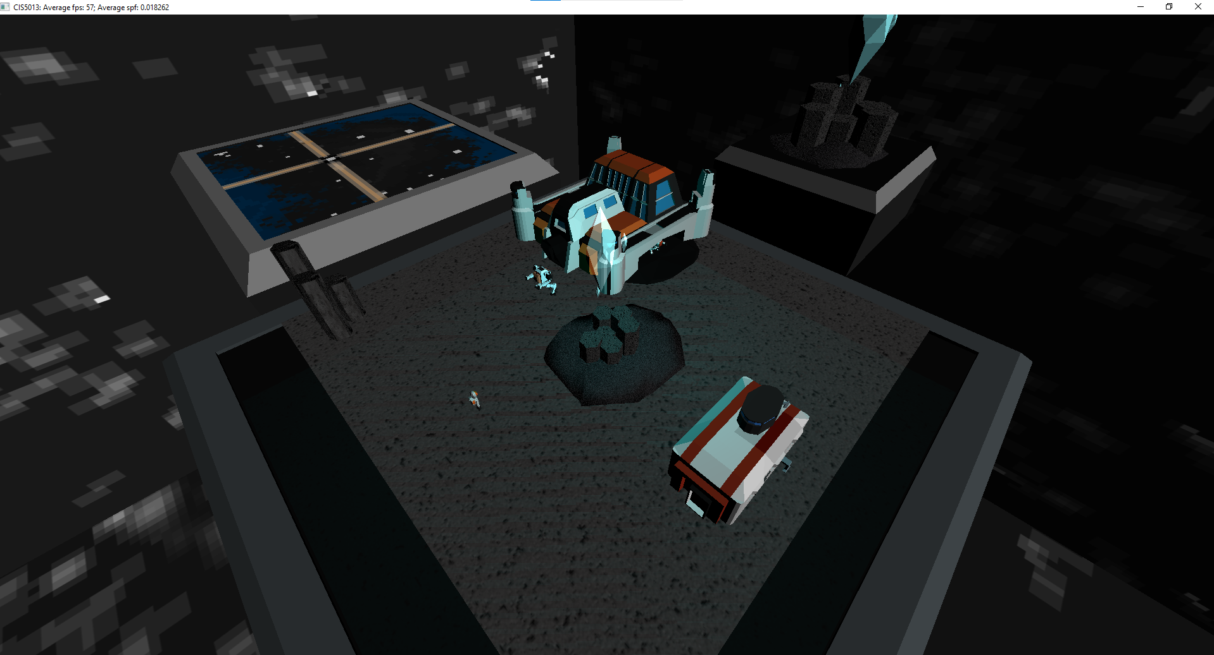

Populus Magos Level 2

